Slide 1


PRIORITY RISK IDENTIFICATION AND SCOPE MEASUREMENT
Final Presentation
5th December 2022

Slide 2
Group Members
Yuthika Shekhar
Abhijeet Talaulikar
Sajid Hussain
Hailey Thanki
Siddharth Susarla
Mentor – Cantay Caliskan

Slide 3
Agenda
Introduction
Data Overview
Exploratory Analysis
Statistical Analysis
Results/Key Insights
Challenges
Next Steps

Slide 4
01
Introduction

Slide 5
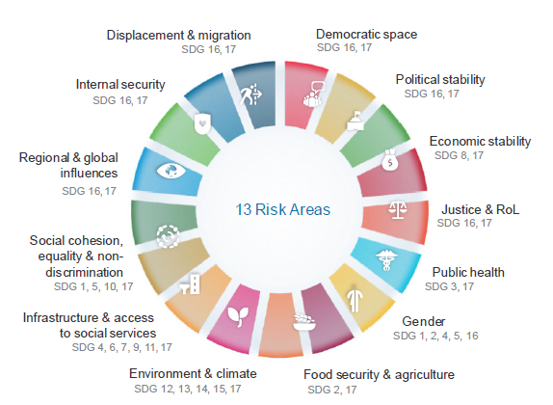
Project Vision and Goals
Goals
Identify which survey variable is the best predictor of priority risks.
Identify which survey variable is the best predictor of UN action urgency and its extent.
Vision
To improve UN's country and regional prevention efforts, by supporting enhanced early warning and early action in the UN system through better understanding of the predictors of risk, UN action urgency and its extent.

Slide 6
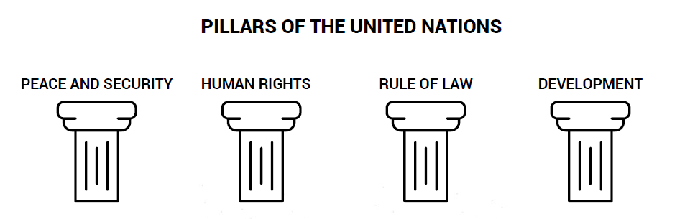

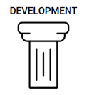
United Nations
The United Nations is an international organization with 193 Member States.
Regional Monthly Review (chaired by Secretary General) body conducts bi-annual surveys.
The Secretary General (António Guterres) is responsible for taking actions on the identified urgency of risk factors

Slide 7
Milestones
MILESTONES | DATE
Created and presented project charter to sponsor | 10/04/2022
Presented initial insights and findings to sponsor | 10/19/2022
Presented results and correlated factors to priority risk areas to sponsor | 10/31/2022
Perform model building on new data | 11/15/2022
Presented results and correlated factors to UN Action Urgency to Sponsor | 11/20/2022
Complete Final Presentation | 11/25/2022
Complete script, dashboard, report and hand over to sponsor | 12/9/2022

Slide 8
02
Data Overview

Slide 9
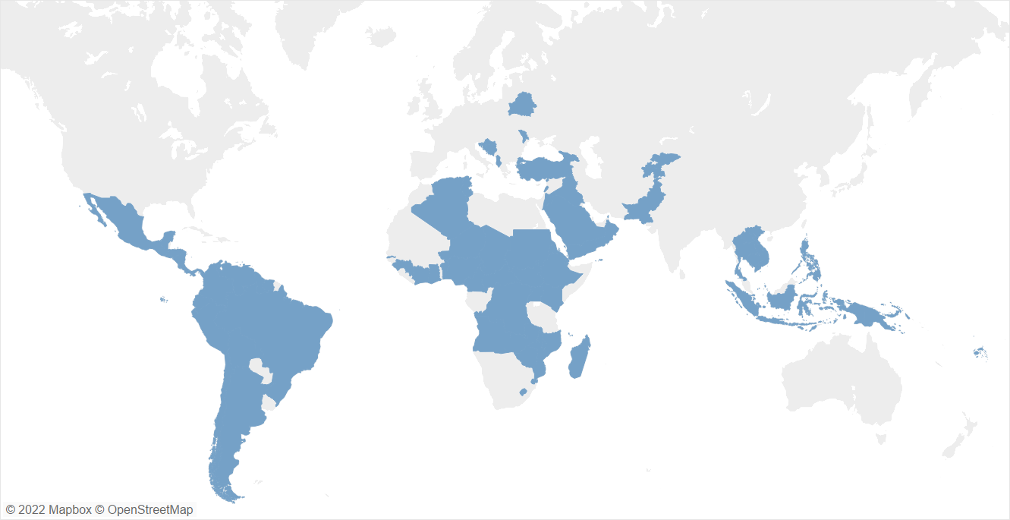
Data Overview
~65 surveys
4 years (2019 to 2022)
58 countries
62 UN entities 667 participants
Size of the data:
Rows: 20K+
Columns: 7

Slide 10
Survey Questions (Predictor/Outcome Variable)
6 question types.
Example questions
Change in UN engagement by extent and urgency: [Outcome Variable] From your perspective, would the scenario you identify require a change in UN engagement over the next 6 months?
Priority risks: (Multi-select) [Outcome Variable] Please select the risk areas you would like to identify as a priority for the RMR discussion.
Identity and demographics: [Predictor Variable] Please select your entity from the drop-down list. If you are submitting for the Resident Coordinator or equivalent, please ensure to select 'UN Resident Coordinator’.
National coping capacity: [Predictor Variable] How do you assess national capacity to cope with the identified risks?
Risk increase potential: [Predictor Variable] Are there indications that the risk related to environment & climate could increase over the next 6 months to an extent that it should be a priority in the upcoming RMR discussion, also bearing in mind the implications of the COVID-19 pandemic?
UN response capacity: [Predictor Variable] How do you assess local un system capacity to engage and help address such risks?

Slide 11


Interpretation of Missing Data
Non-response bias: Survey participants may answer a question with “Don’t know” or skipped the question.
Question was not asked: Surveys have been evolving – older surveys do not have some of the questions from newer surveys.

Slide 12
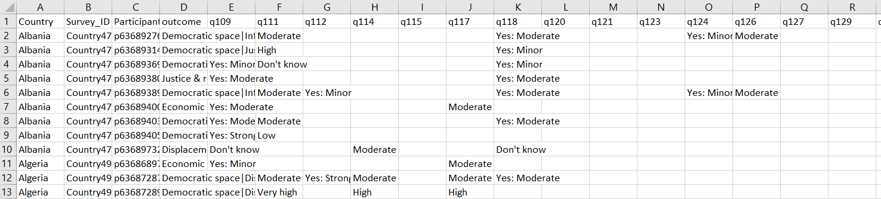

Transformed Survey Data
Treat every survey + participant combination as a row.
Each row can be interpreted as an opinion of a participant in a specific survey about a country.
Columns = maximum number of questions per survey
New size: 860 rows, 48 columns
Participant responses
Question responses

Slide 13
Mapping of Response (Risk Related Questions)
10 qualitative responses presented to participants across surveys
Standardized the weight of the responses using a Net Promoter Score
Response | Score
Yes: Very Strong, Very High | 5
Yes: Strong, High | 4
Yes: Moderate, Moderate | 3
Yes: Minor, Low | 2
No | 1
None , Don't Know | 0

Slide 14
Mapping of Response (Coping Capacity Questions)
There are two types of questions based on coping capacity- National and UN System
6 qualitative responses presented to participants across surveys
Standardized the weight of the responses using a Net Promoter Score
Response | Score
Very High | 1
High | 2
Moderate | 3
Low | 4
None , Don't Know | 0

Slide 15
03
Exploratory Analysis

Slide 16
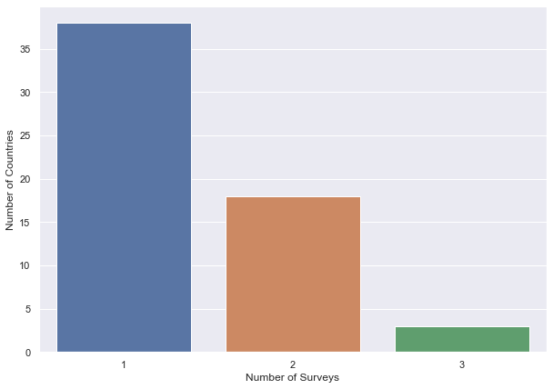
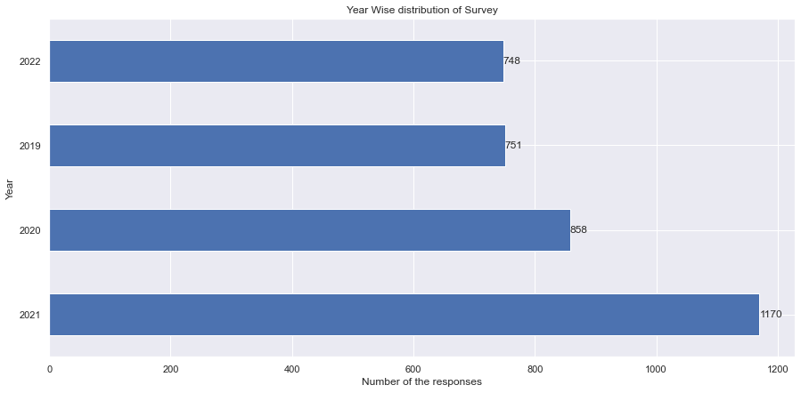
Descriptive Analysis
Distribution of data from 2019 to 2022
38
748
751
Data Size
Number of Countries
18
858
1170
3
Number of Surveys
Typically, countries go through a single survey in a year. However, there may be another survey conducted in a country based on the risks evaluated by analysis team of UN.
85% of countries had a single survey.

Slide 17
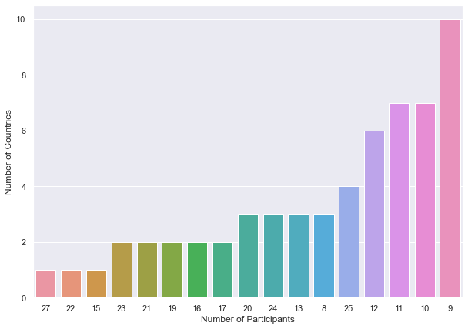
Descriptive Analysis
10
About 24 countries had just 9 to 11 participants take the survey.
7
7
6
4
This does not indicate a fewer number of participants in those countries. All UN entities must participate in the survey for that country.
This chart is, however, useful in showing the participation rate in RMR surveys.
3
3
3
3
2
2
2
2
2
1
1
1

Slide 18
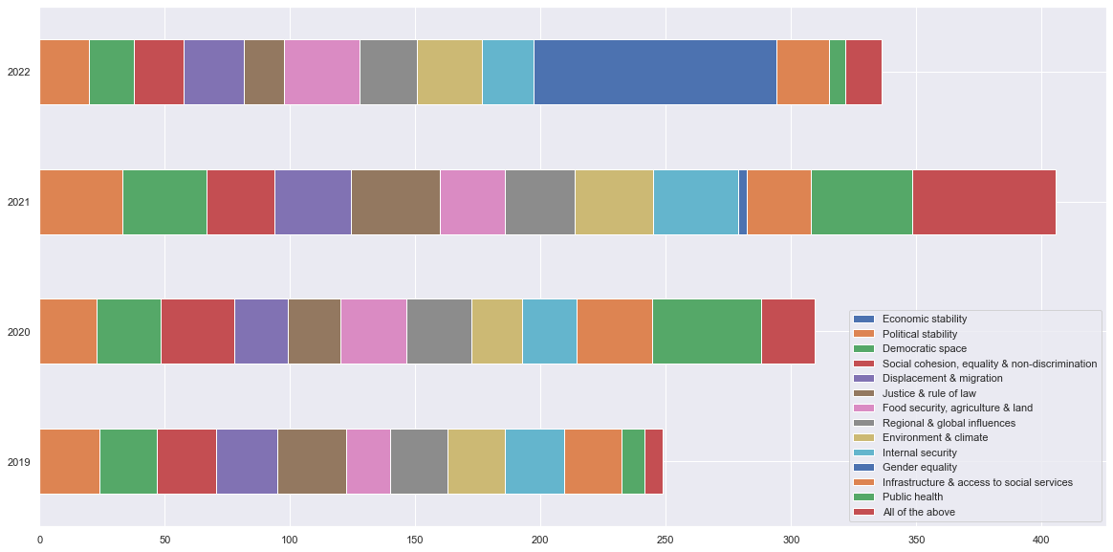
Most voted risk areas by RMR survey year
Year
Votes

Slide 19
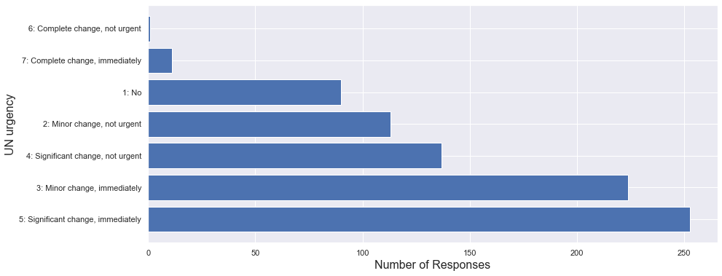

Distribution of UN Extent & Urgency
Majority of the responses, ~ 250 said that there are significant changes which need to be acted on immediately.

Slide 20
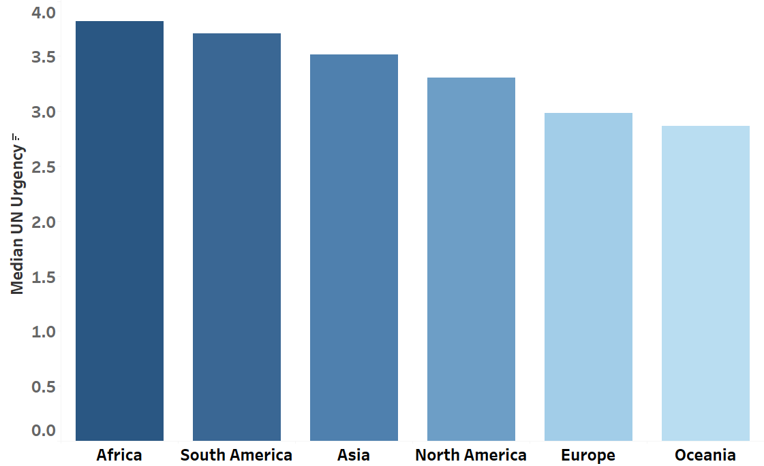
UN Urgency aggregated based on Country
Africa has the highest median urgency across all risk factors and also the highest number of countries in the data.
Oceania has the fewest number of countries in the data which appear to have a low urgency.

Slide 21
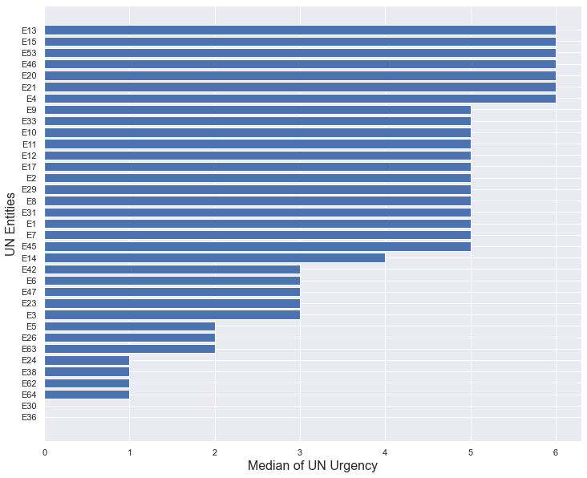




Voting patterns of UN Entities for Extent and Urgency of UN Action
Median is insensitive to very strong positive and negative responses.
~ 60 UN Entities

Slide 22
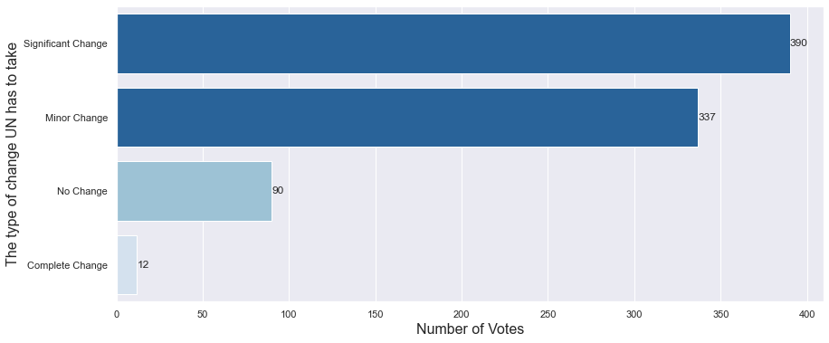
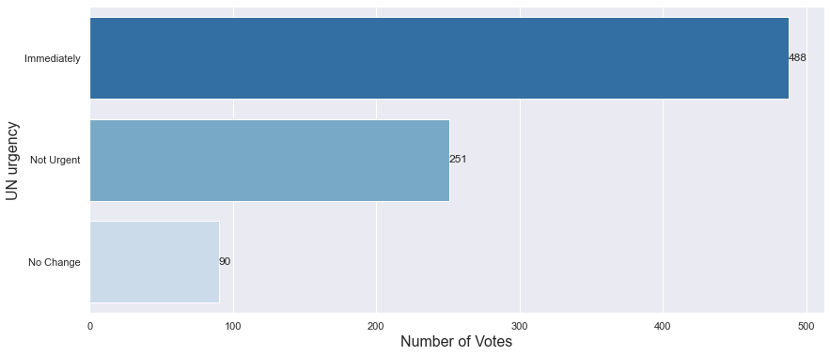
Distribution of UN Extent & Urgency
We observed the UN Extent and Urgency at a much granular level and dealt with them separately.
About 350 participants voted for significant change which UN needs to take.
Over 480 participants voted for immediate UN Urgency.

Slide 23
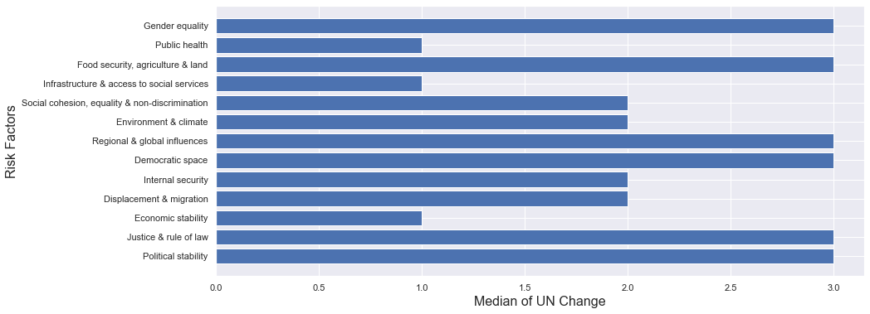
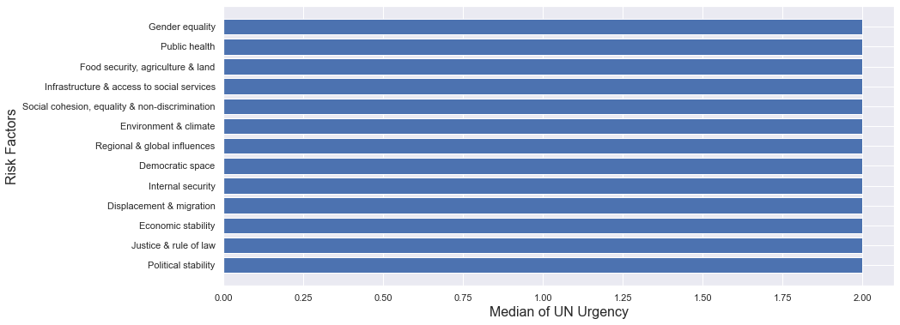
Distribution of UN Extent & Urgency
Interestingly, Economic Stability which was the most common risk factor was voted as requiring minor change.
We find the median urgency to be same across all risk factors.

Slide 24
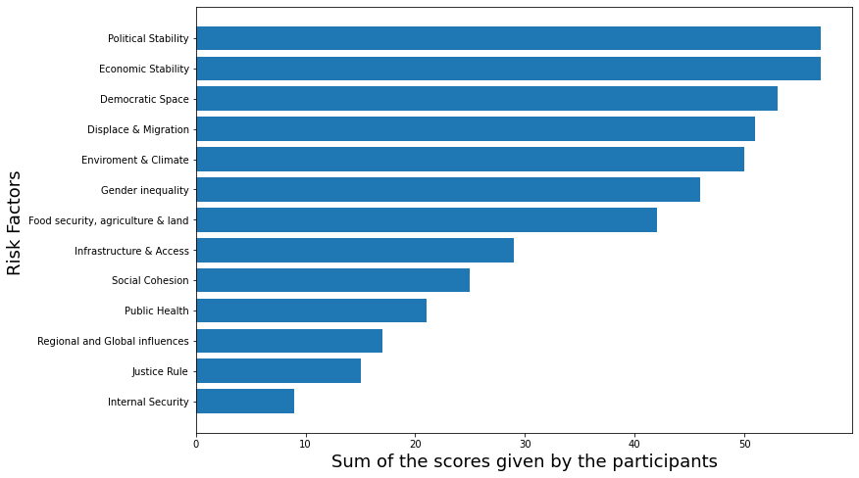
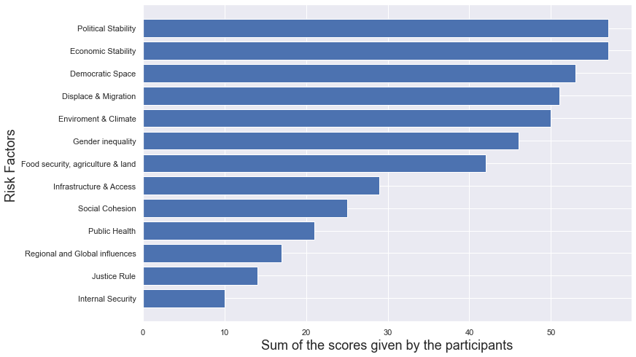
Perception of risk increases across RMR risk areas and surveys
Top 5 risk predictors, globally aggregated based on sum of scores

Slide 25
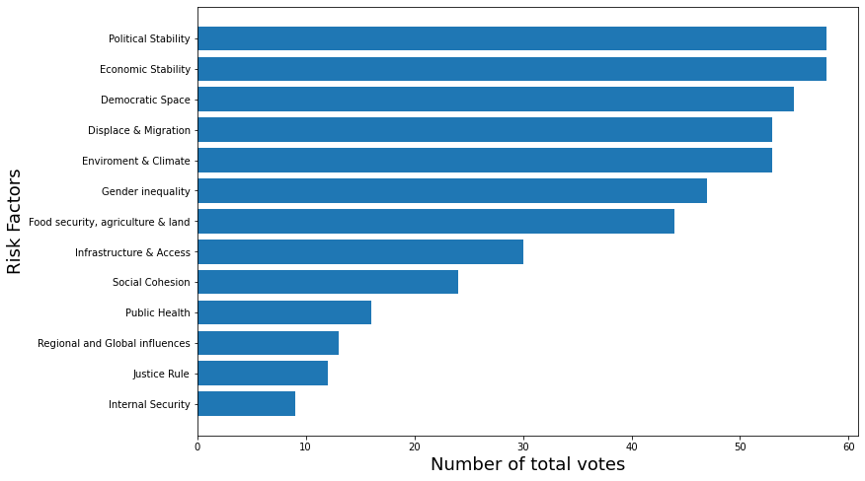
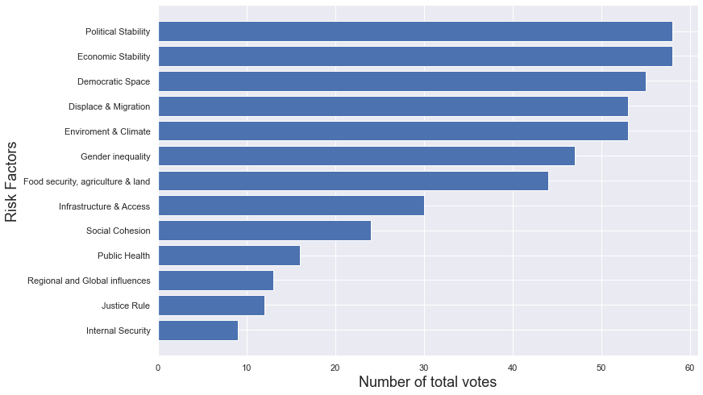
Consesus of risk increases across RMR risk areas and surveys
Top 5 risk predictors, globally aggregated on number of votes

Slide 26
04
Statistical Analysis

Slide 27
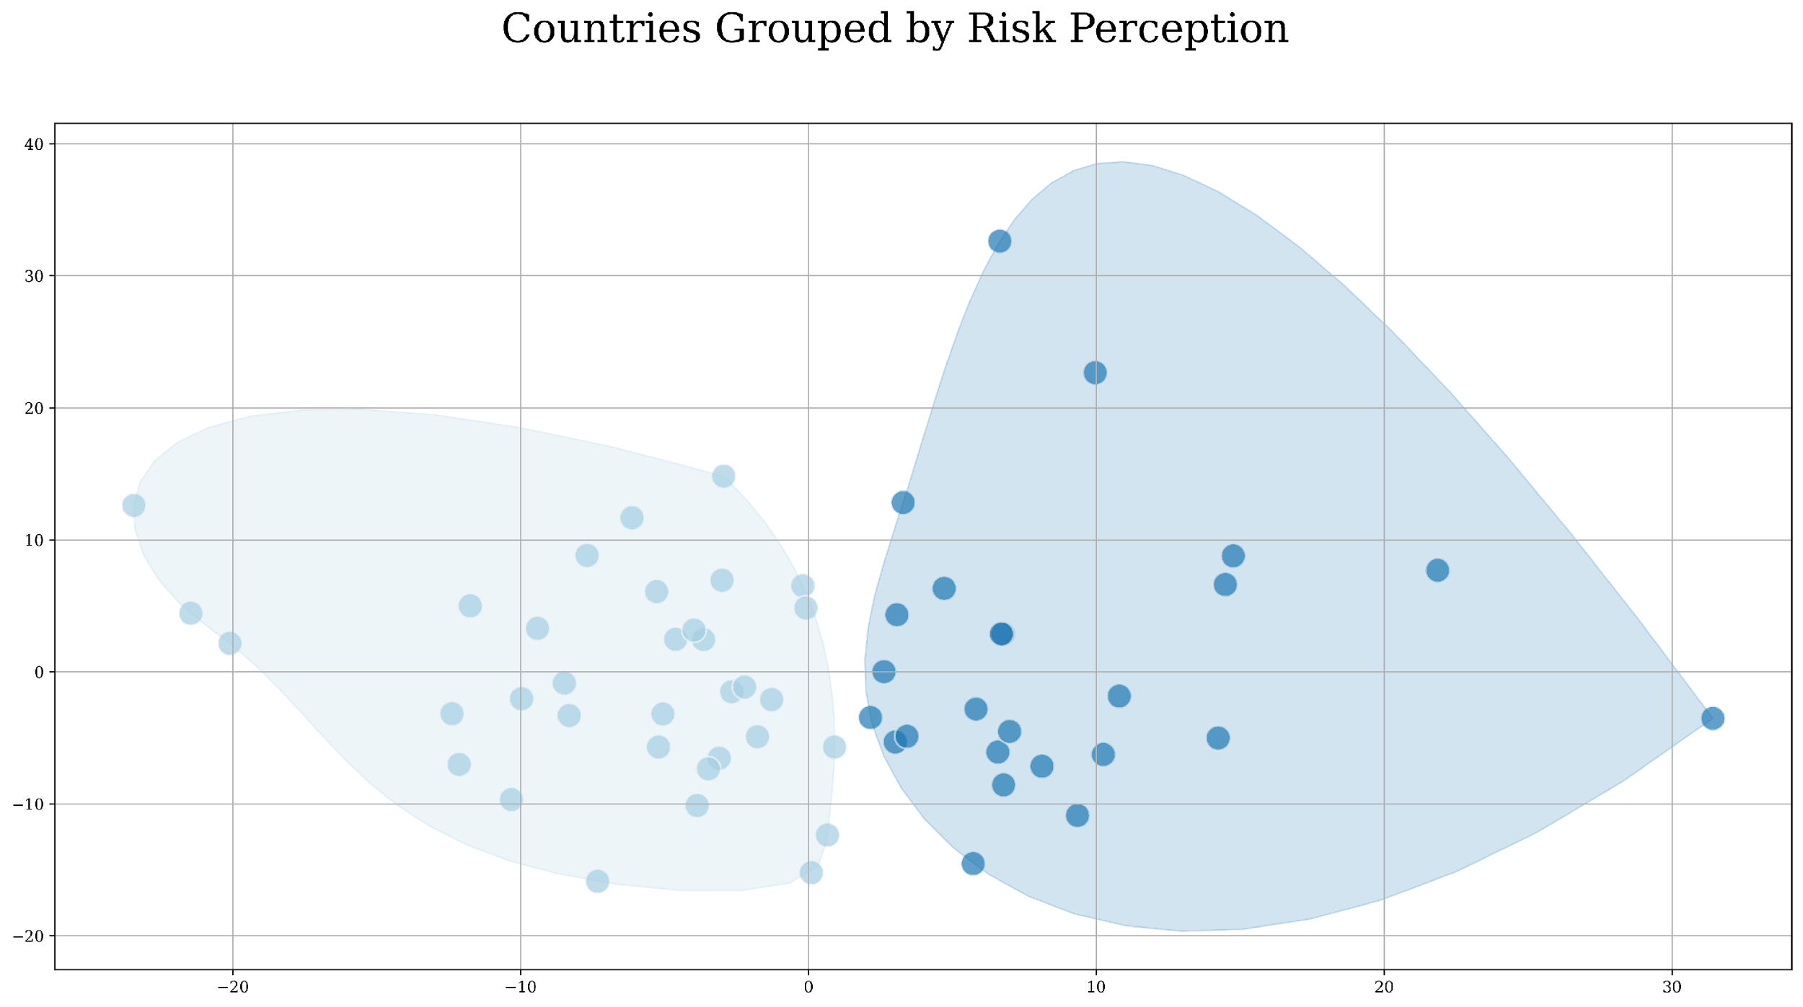
Priority Risk Clusters
Grouping countries based on participant perceptions of the 13 risks.
Goal: Enabling UN to standardize their actions based on similar risks.
Features: 13 features for prevalence of risk factors
Algorithm: K-Means + Silhouette Analysis (For number of clusters)
Clustering based on data from latest 2 surveys which are 6 months apart.
Cluster C1:
Economic stability, political stability and public health are a concern.
Food security is perceived as a risk.
Cluster C2:
Overall risk, no distinguished characteristics.
C2
C1
PCA Dimension 2
PCA Dimension 1

Slide 28
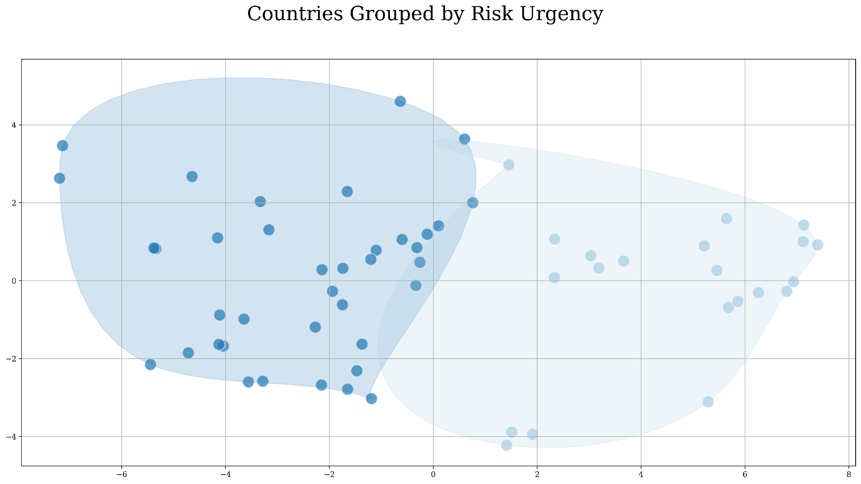
Urgency Assessment Clusters
Grouping countries based on participant perceptions of urgency in UN intervention.
Goal: Enabling UN to allocate resources to countries in effective timeframes.
Features: 7 qualitative features for UN action urgency.
Algorithm: K-Means + Silhouette Analysis (For number of clusters)
Clustering based on data from latest 2 surveys which are 6 months apart.
Cluster C1:
Countries in this cluster believe that UN intervention needs a complete change, and it needs to happen immediately.
Cluster C2:
Countries in this cluster believe UN needs to enact some minor changes immediately but significant changes are not urgent.
C1
PCA Dimension 2
C2
PCA Dimension 1

Slide 29
Priority and Impending Risks
Algorithm: FP-Growth
31% Priority risk - Food Security
27% Priority risk - Democratic Space
27% Priority risk - Social Cohesion
25% Priority risk - Social Cohesion
23% Priority risk - Social Cohesion
23% Priority risk – Democratic Space
When economic stability, political stability, democratic space or justice are an identified risk, 30% of the participants thought the UN engagement needed a significant change over coming months.
Impending risk - Economic Stability
Impending risk - Political Stability
Impending risk - Political Stability
Impending risk - Democratic Space
Impending risk - Justice & Rule of Law
Impending risk - Justice & Rule of Law
Notes:
Relation between risk and impending risk will be explained during presentation

Slide 30
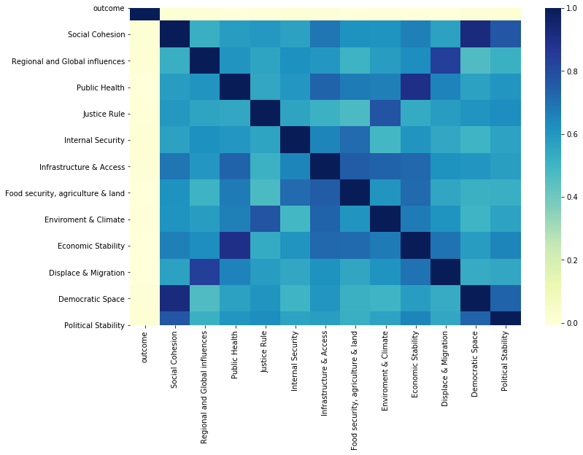
Can we predict a country’s current risk?
Goal: Predict priority risks using answers to other questions.
Insignificant Correlation with Outcome
Metric: F1- Score
Since the outcome is a multi-select variable, we need to look at both Precision and Recall.
Risk Factors
Model Performance:
Random Forest: 50%
Naïve-Bayes: 10%
Severe Class Imbalance:
Infrastructure & access to social services – only 45 instances
Internal Security – only 114 instances
Questions’ Answers

Slide 31
05
Results/Key Insights

Slide 32
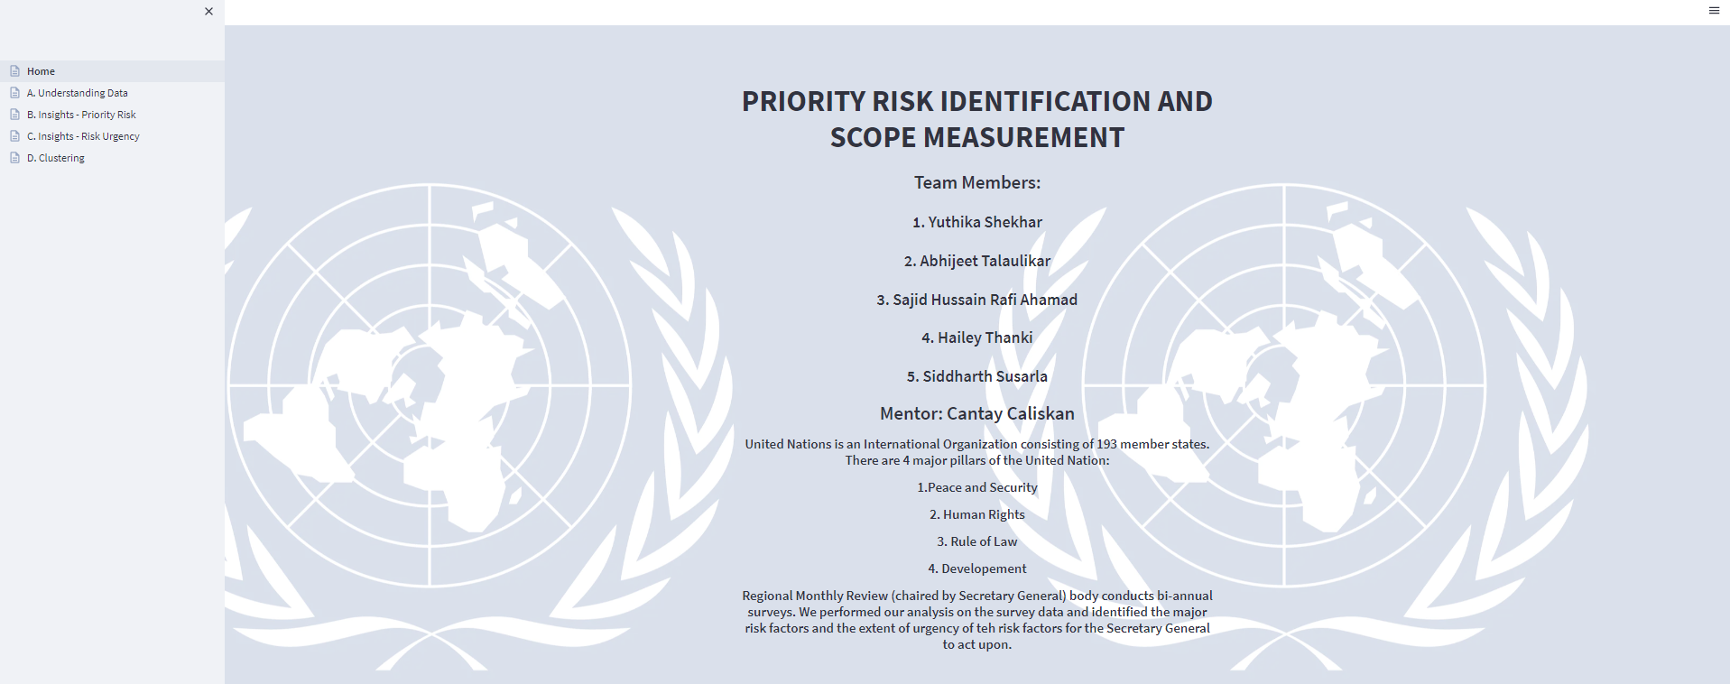
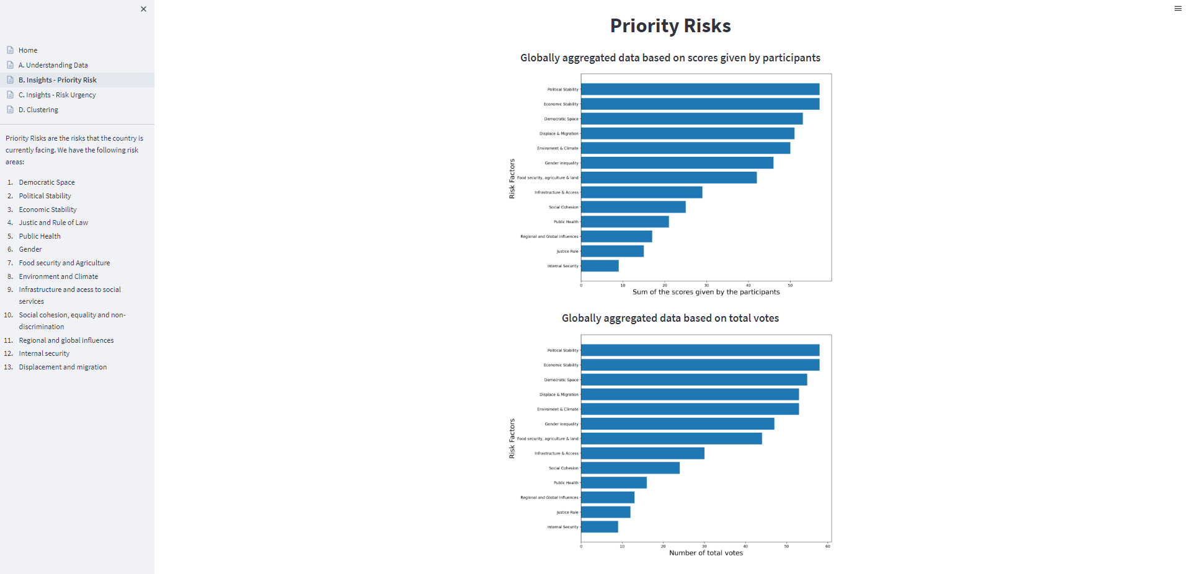
Dashboard
We presented our results and insights to the UN using the dashboard created on Streamlit.
All our analysis and insights were divided into different categories and presented as different tabs on the Streamlit dashboard.
Notes:
URL : http://192.168.1.144:8501

Slide 33
Outcomes
There were notable patterns between priority and impending risks. The absence of social cohesion indicated a higher chance of economic/political stability.
Most questions were asked conditionally based on other answers. This led to a 1-1 mapping with the priority risk and hence were the best predictors.
We created scripts that automated the process of generating the dashboard that helps UN understand the survey results better.
It helped UN get a holistic picture of risks that countries under the RMR scanner are facing and their urgency.

Slide 34
06
Challenges

Slide 35
Major Challenges
Data sparsity issues
Slow data gathering
Small surveys
Anonymized data due to UN Privacy policies

Slide 36
07
Next Steps

Slide 37
Suggestions
Maintaining a Survey IDs for each survey
Maintaining Question IDs
Ask more mandatory questions irrespective of conditions
Involve common people in surveys apart from UN Entities to better understand the severity of risk in the country

Slide 38
Acknowledgements
We would like to thank the entire UN team (Luzal Anand, Robert Samupindi and Jessica Summers) for providing us the data and in helping and guiding us throughout the project.
Thanks to Prof. Cantay Caliskan for providing us friendly feedbacks in bi-weekly meetings which helped us to work and improve on our presentation skills.

Slide 39
Thank You

